Slide 1
Real Estate Association Presentation
07/15/2021

Slide 2
What Does the Inspection Department Do?

Slide 3
What Does the Inspection Department Do?
North Carolina General Statute 160D-1104
Inspects construction, renovation, additions, repair and other structures
Inspects plumbing systems (new, renovating, addition, and repair)
Inspects electrical systems (new, renovating, addition, and repair)
Inspects mechanical systems (new, renovating, addition, and repair)
Heating & Cooling Appliances & Ductwork
Gas Appliances & Gas Piping

Slide 4
What Does the Inspection Department Do?
Enforces the North Carolina Technical Building Codes, which consist of:
Building Code
Residential Code
Manufactured Building Code
Electrical Code
Plumbing Code
Mechanical Code
Existing Building Code
Fuel- Gas Code
Energy Conservation Code
Law and Administrative Code
ANSI A117.1 (Accessibility Code) Not ADA.
Fire Prevention Code

Slide 5
What Does the Inspection Department Do?
City of Fayetteville’s Inspections Division does not do:
Safety Inspections
Home Inspections
How-to-build _______
Design
Make structural judgements

Slide 6
Permits Required

Slide 7
Permits Required
North Carolina General Statute 160D-1110
General Statute and Code will reference what is required and what is not required.
If permit is not required, does not exempt from meeting state code.

Slide 8
Work Without A Permit

Slide 9
Work Without A Permit
Generally, Cumberland County Tax Office will have a building listed one way and on-site visit shows something else!
Home –Inspector finds issue
Contractor finds issue
Perspective Home Buyer finds issue
Inspections Division has no record of permit or permit never received inspections

Slide 10
Work Without A Permit
What next ?!?!?!
Generally will require a Licensed General Contractor.
Will require permits
Will require “destructive” inspections
Engineers can no longer sign off

Slide 11
Rental Property

Slide 12
Rental Property
North Carolina General Statute 160D Article 12 (minimum housing)
City of Fayetteville Code of Ordinances Chapter 14
Property must be maintained.
Not the tenant’s responsibility. Tenant cannot pull certain permits by state law.

Slide 13
Home Inspectors

Slide 14
Home Inspectors
North Carolina General Statute 143-151.58
North Carolina Administrative Code Title 11, Chapter 8
Must be state licensed
Has limitations on what they can and cannot inspect.
https://www.ncosfm.gov/licensing-cert/home-inspector-licensure-board-hilb

Slide 15
How to use E-Development Portal

Slide 16
How to use E-Development Portal

Slide 17
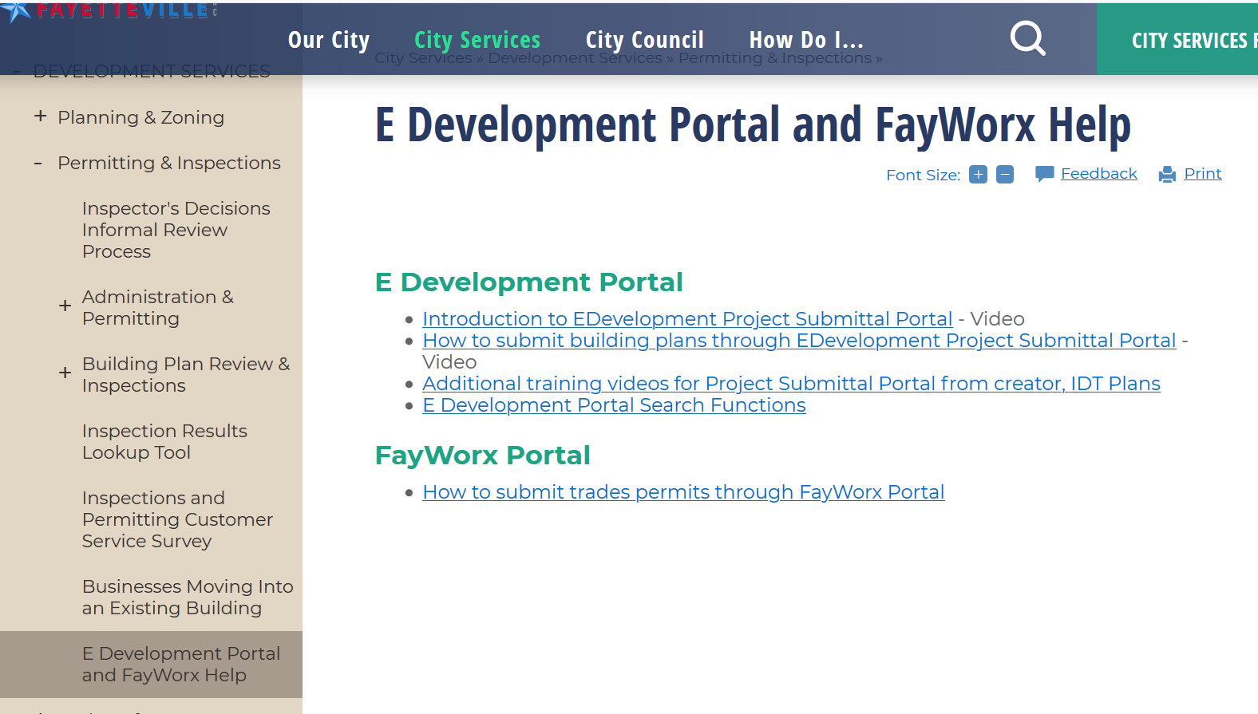
How to use E-Development Portal

Slide 18
Change of Occupancy; Change of Use; Change of Occupant

Slide 19
Questions

